Slide 1
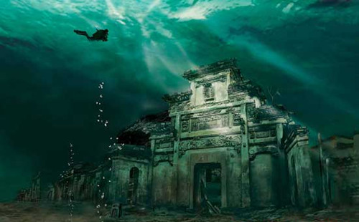
MYSTERIOUS PLACES ON EARTH

Slide 2
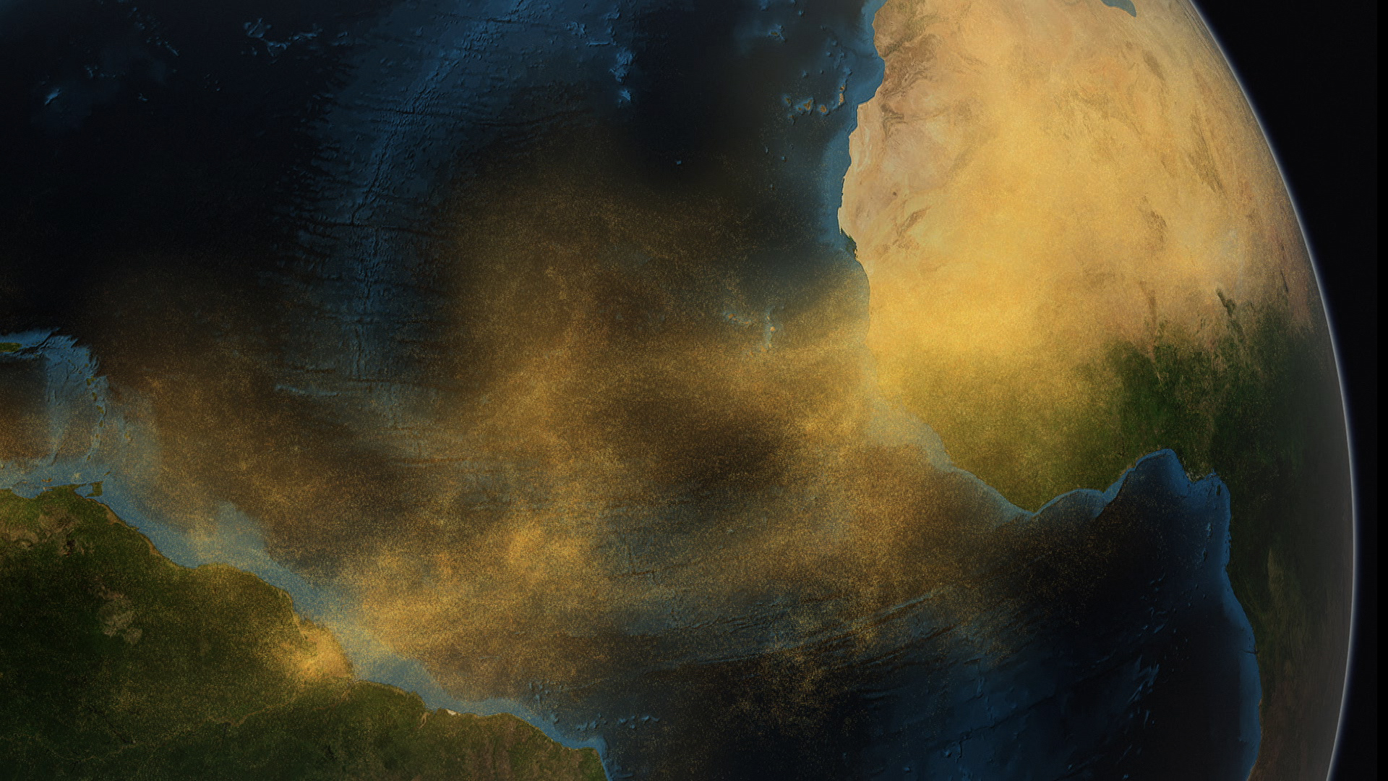
SOUTH ATLANTIC ANOMALY

Slide 3

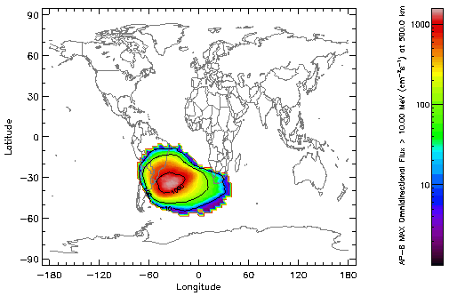
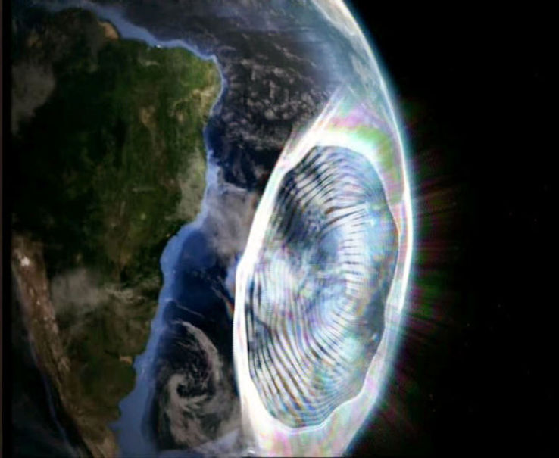
South Atlantic Anomaly is also called ‘BERMUDA TRIANGLE IN SPACE’. It is one of the most dangerous areas of radiation ever encountered. This anomaly is found 300 km off the coast of Brazil in the South Atlantic ocean. Researchers have also nicknamed it as ‘the duck’ for it’s shape.

Slide 4
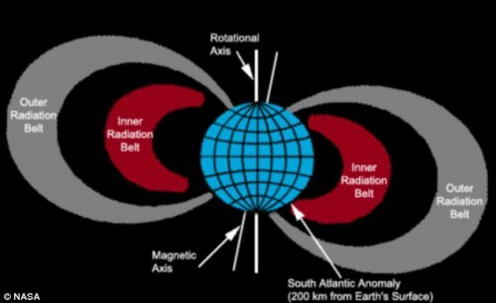
SCIENTIFIC APPROACH
This is the area where the Earth's inner Van Allen radiation belt (ring of charged particles) comes closest to the Earth's surface dipping down to an altitude of 200 km (124 mi). This happens due to the asymmetrical intersection between the rotational axis and the magnetic axis

Slide 5
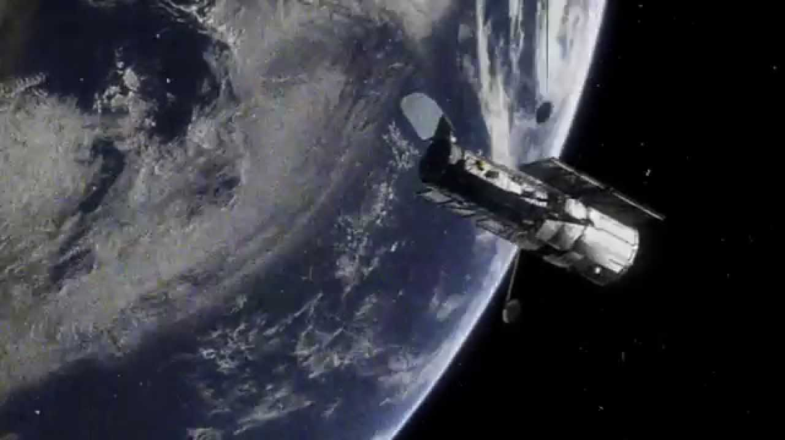
EFFECTS
Causes all sorts of malfunctions in spacecrafts electronics. LEO range satellites face problems in SAA.
Satellites that travel in this region are shut down, or go into SAFE mode to avoid damage while passing over the Atlantic between Brazil and Africa.
Astronauts turn of their EVA activities so as to avoid radiation exposure.

Slide 6
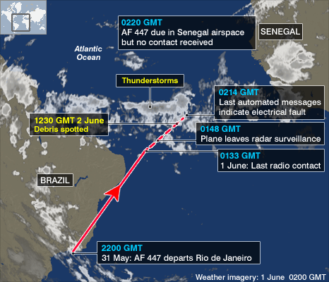
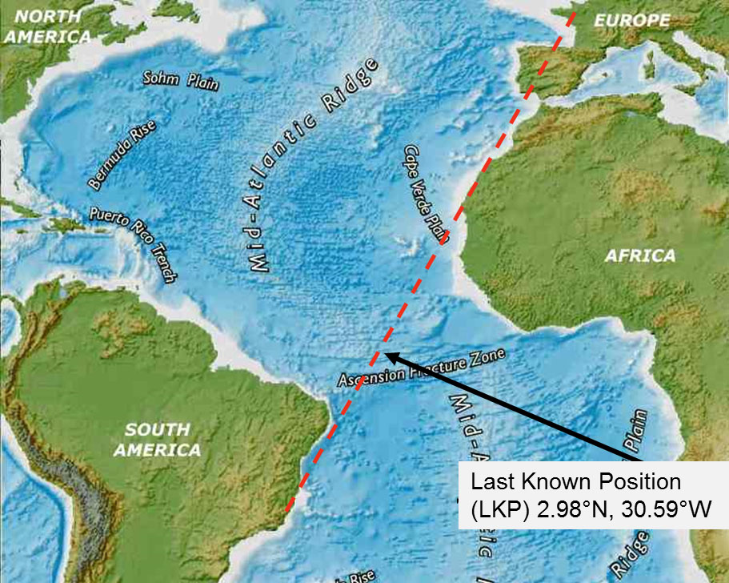
TRAGEDY
Many are of the believe that SAA is the reason behind the crash of Air France flight 447 (AF447/AFR447) flying from Galeao Airport of Rio de Janeiro to Charles de Gaulle Airport of Paris on June1 2009, in which 228 people died.

Slide 7
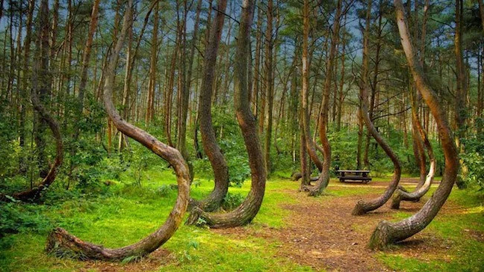
HOIA – BACIU FOREST

Slide 8
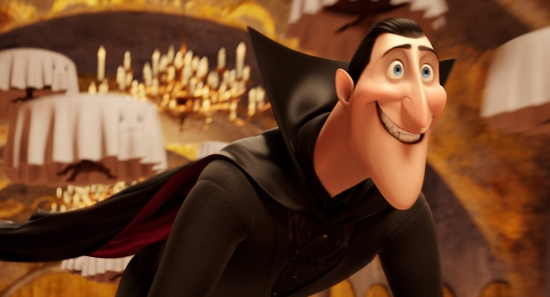
DRACULA
Transylvania in central Romania is famous for its legends of Dracula and its primitive towns and castles. With mountainous borders Transylvania is rightly called ‘land beyond the forests.’ This notorious area shelters the most haunted forest in the world, The Hoia-Baciu Forest.

Slide 9
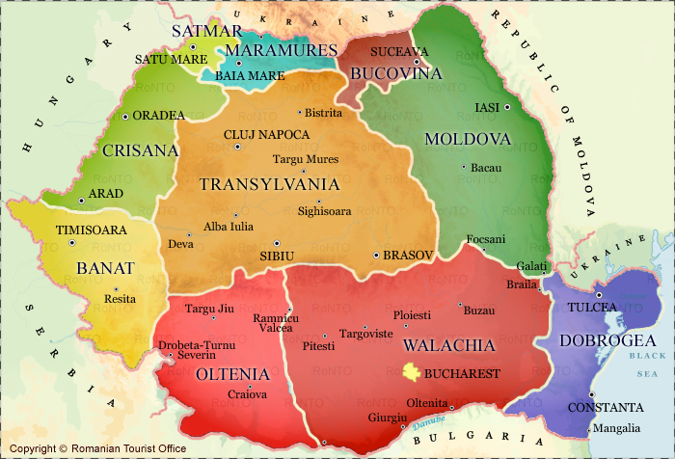
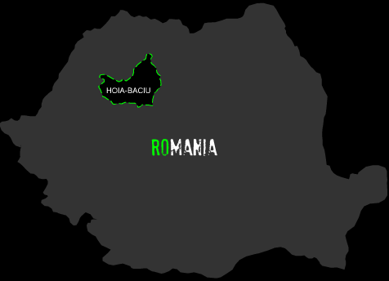
The Hoia-Baciu forest situated outside the city of Cluj Napoca, Romania is known as the “Bermuda Triangle of Transylvania“ , because of the mysterious happenings and paranormal activities there. The forest got its name from a mysterious occurrence. In Roman, ‘Baci’ means sheepherder. It is said that a local shepherd disappeared in the forest with his 200 sheep. They were never seen again.

Slide 10
PARANORMAL ACTIVITIES
The people around the forest believe that one who enters the forest never returns. They believe that the forest is haunted by the spirits of the peasants who were brutally murdered in the forest. These spirits punish those who enter the forest. Many have heard strange laughter and sounds from trees. Some visitors have seen strange faces without bodies suddenly appearing from nowhere. People who entered the woods came out with unexplained rashes, scratches and burns. Some also got headaches, nose bleeds and experienced nausea.
Some believe that the forest might be a gateway to another dimension or is the boundary between our world and another world. Many visitors have reported experiencing missing time when in the forest.

Slide 11
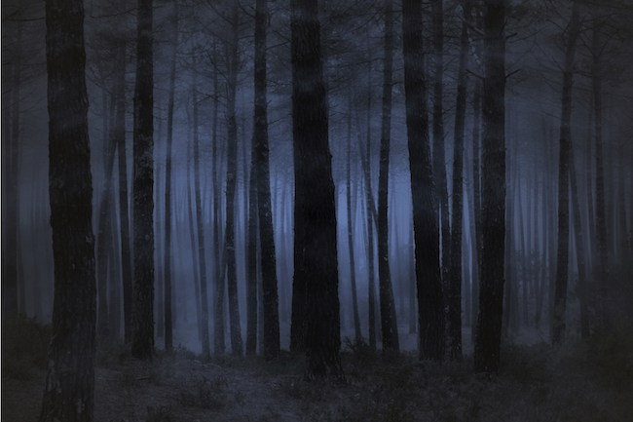
Spooky foggy forest at night
The photographs taken in the forest showed shadowy figures and images that were not present when the photos were clicked.

Slide 12
UFO Sightings
Many have reported of UFOs flying over the area. The reason of disappearances is also linked with alien abductions. The forest became famous for its UFO sightings in 1968. A biologist named Alexandra Sift had come to the forest to study the strange phenomena occurring there. She captured images of a strange disc shaped object flying over the forests. Then in the same year Emil Barnea, a military technician also clicked clearer photos of the similar objects. In the 1970s the Hoia-Baciu forest became famous for the UFO sightings.

Slide 13
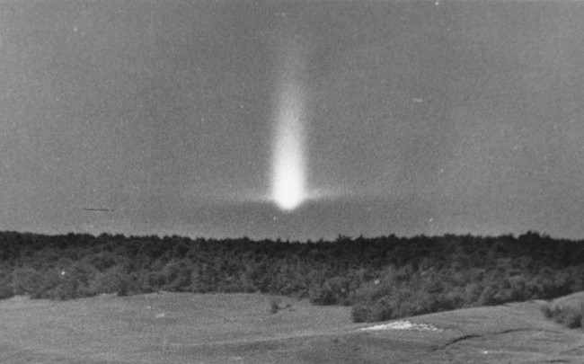
UFO sighting at Hoia Baciu forest

Slide 14
A SCIENTIFIC APPROACH...
Many believe that the forest is indeed a home to paranormal activity and UFOs. One of the theory that was proposed was about the ultra-low frequency sound waves. It was said that may be the forest is a source of such waves that cannot be heard by a human ear. These sound waves however can create acute physical effects from their vibrations. These waves also may be the cause of the audio and visual hallucinations and also cause of the physical discomforts the visitors faced in the forest.

Slide 15
STRANGE INCIDENT
One of the experience is that of a five-year old girl. She went in the woods and got lost. Many searched, but found no sign of the girl. Five years after this incident the locals found the same girl crying outside the forest. The girl still looked five year old and her clothes also were the same. The girl did not remember anything about those five years when she went missing.

Slide 16
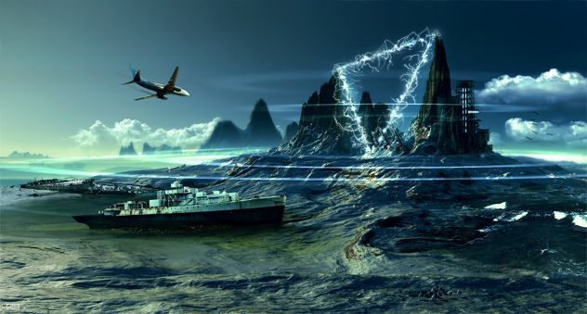
THE DEVIL SEA

Slide 17
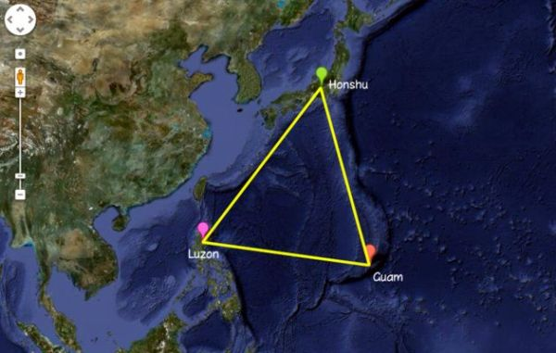
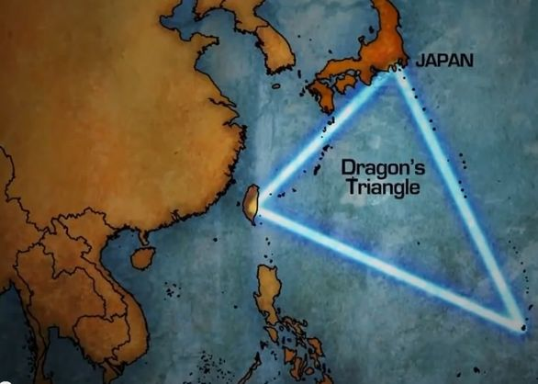
The Devil's Sea is known for its paranormal disturbances. It is a triangle between Japan and the Islands of Bonin, including a major portion of the Philippine Sea (100 km south of Tokyo). It is also known as the ‘DRAGON TRIANGLE’ or the ‘FORMOSA TRIANGLE’ or the ‘PACIFIC BERMUDA TRIANGLE’.

Slide 18
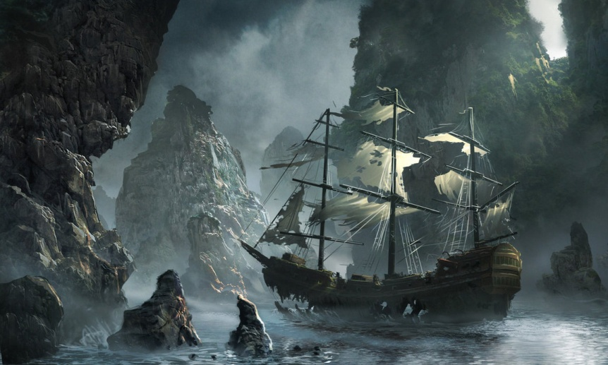
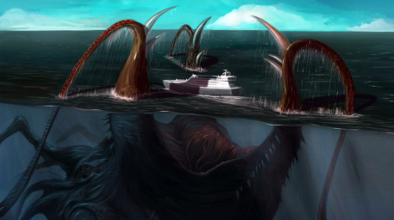
Often compared to the Bermuda Triangle, the Dragon's Triangle is an area where ships and aircraft allegedly mysteriously disappear. Besides disappearing planes and ships, phenomena that are linked to the Dragon's Triangle include ghost ships, UFOs, USOs, lapses in time, and electronic equipment malfunction.

Slide 19
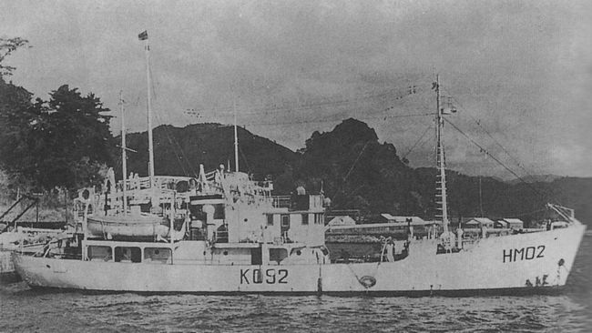
DISAPPERANCES
In 1952 the Japanese government sent out a research vessel, the Kaio Maru No. 5, to investigate the mysteries of the Devil’s Sea. Naturally, of course, the Kaio Maru No. 5 and its crew of 31 people were never seen again.
The Kaio Maro ship No.5 - 1952

Slide 20
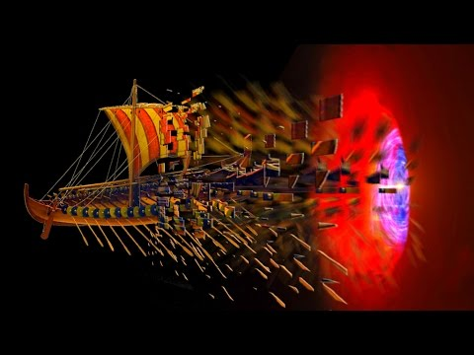
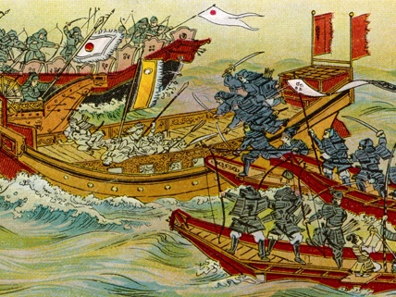
Another story tells us that Kublai Khan, the leader of Mongol attempted to invade Japan in 1260 AD by crossing the Devil’s Sea and lost at least 40 000 men in the process with all ships . Some believe the ship were destroyed in a typhoon in the area

Slide 21
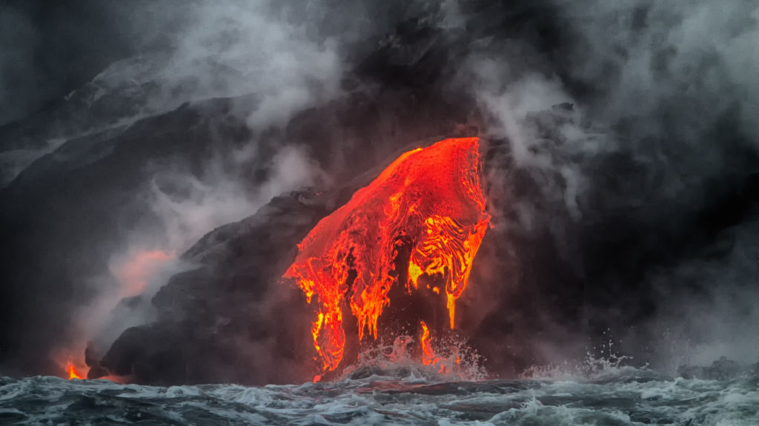
THEORIES
There are myths about this area from aliens, to gates to parallel universes, even to Atlantis. Some suggest that high volcanic activity in the region is responsible for some of the disappearances (the Kaio Maru No. 5 may have been caught in an eruption).

Slide 22
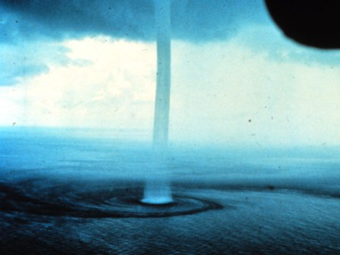
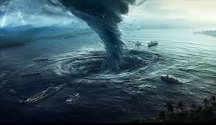
A SCIENTIFIC APPROACH...
Scientifically speaking, the Dragon’s Triangle is said to be one of the world’s 12 existing vile vortices. Vile vortices are those areas where the pull of the planet’s electromagnetic waves is stronger than anywhere else. Maybe this is how the ships were disappearing.

Slide 23
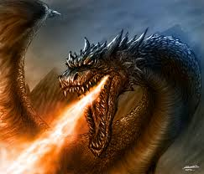
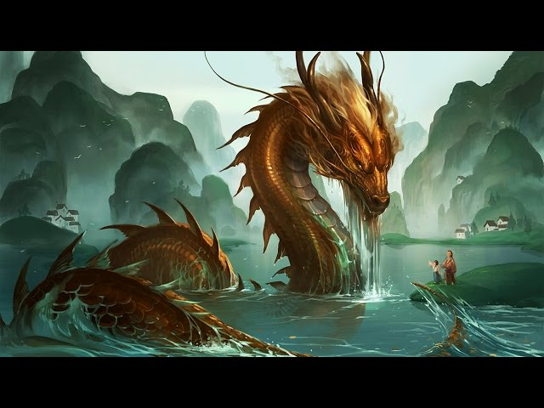
MYTH
According to the myth, dragons live deep beneath the surface and their movement can suddenly churn up waves, whirlpools, thick fog, and sudden storms.

Slide 24
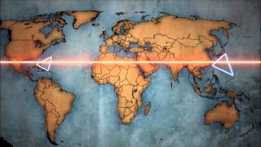
REFERENCE TO BERMUDA TRIANGLE
The Bermuda triangle and the dragon triangle lie in the same magnetic line and cause the same disastrous phenomena. These are the 2 main vile vortices causing paranormal activities

Slide 25
THANK YOU

